Slide 1
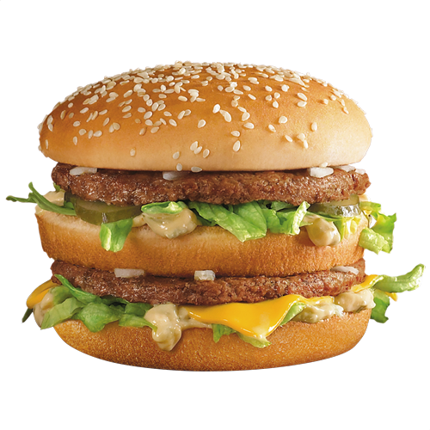

CISC3003 Project Topic: Customization of McDonald’s Burger

Slide 2
Inspiration
As we all know that in McDonald’s self-ordering machine, you can customize your burger by tapping the checkbox of the burger’s ingredients, but it also comes a drawback, that is the machine would not show the image of the changed-burger after you manipulate the checkbox, and that is what we are going to do.

Slide 3
What our website need?
Front-end
An interactive interface (which should be similar to Mcdonald’s self-ordering machine, like contains some checkbox of burger’s ingredients, the image of the burger(which can be changed after users make some changes on the burger),etc.
A user sign up interface and login interface
An account information list for delivery
Check out button to confirm user’s order

Slide 4
What our website need?
Back-end
A database contains
Information about McDonald’s available burgers.
Price of each ingredient

Slide 5
Front-end Interface

Slide 6
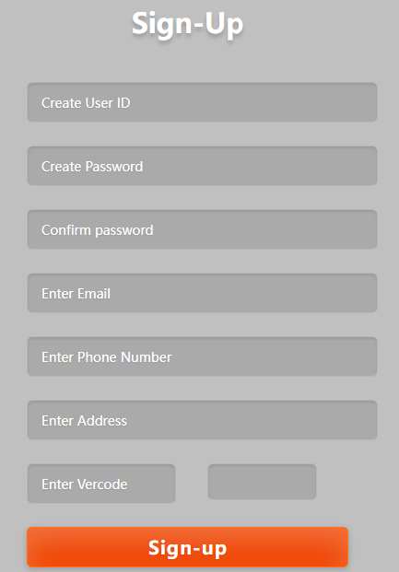
Sign-up interface
ID
Password
Confirm
email
Phone
Address

Slide 7
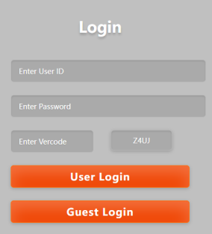
Login Interface
ID
Password
Vercode
User Login
Guest Login

Slide 8
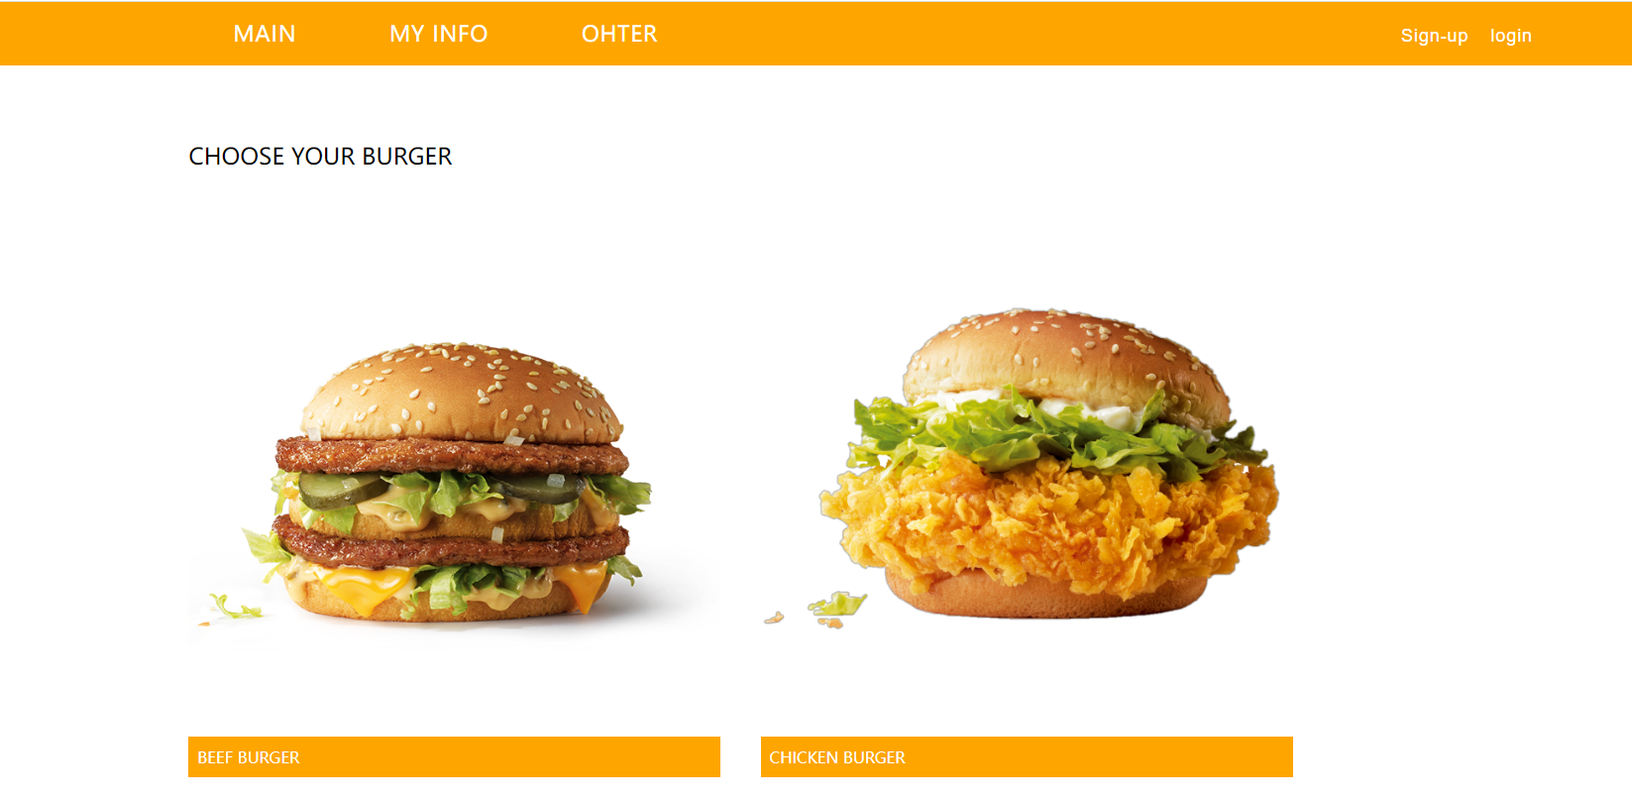
Main Web
Navigation bar
Big Photo Choice

Slide 9
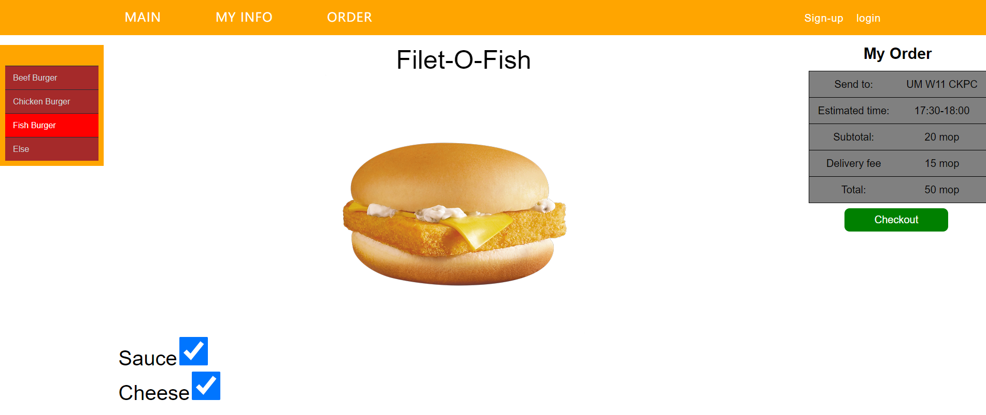
Order Web

Slide 10
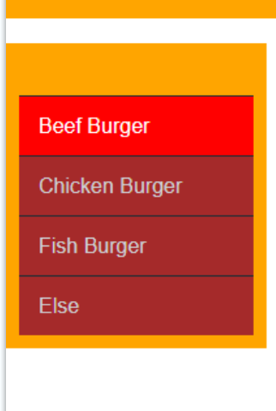
Menu Bar

Slide 11
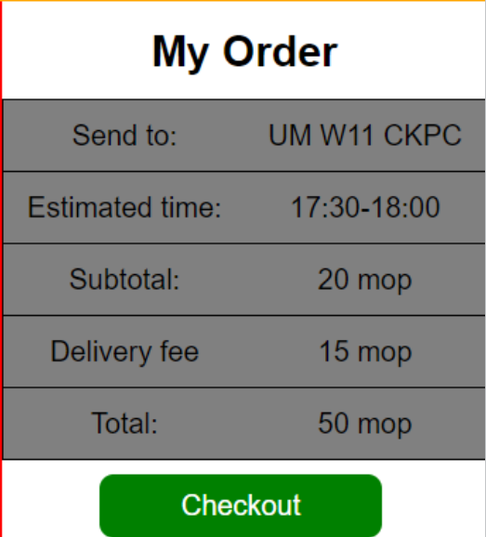
Order Bar
Address
Time
Subtotal
Delivery fee
Total

Slide 12
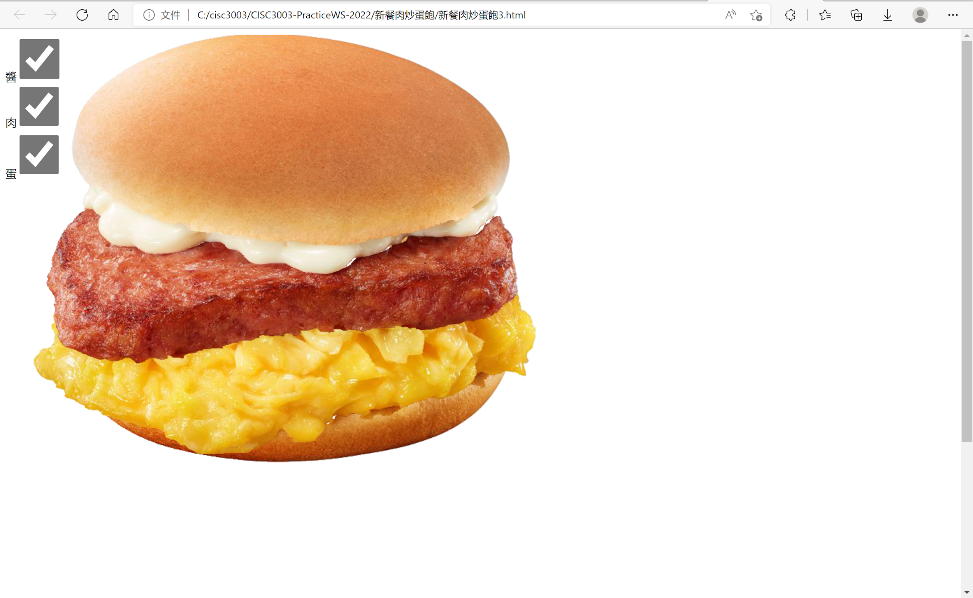
Our progress

Slide 13
Q&A

Slide 14
Thank you

